Slide 1
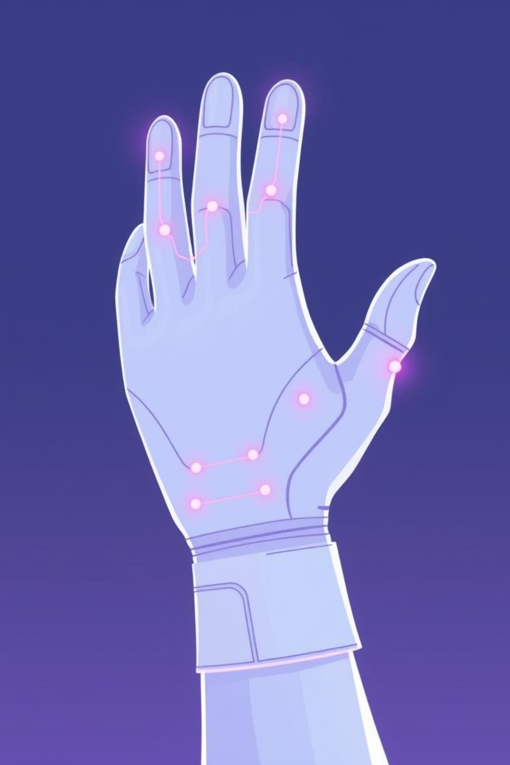
Vital Monitoring Glove – Design & Analysis
Open Lab I – Review 2
Presented by:
Mugilan S S – [CB.EN.U4CCE23026]
Veankata Krishnan S M– [CB.EN.U4CCE23042]
Kushal R V– [CB.EN.U4CCE23065]

Slide 2
Core Objectives
Real-time Vital Monitoring
IoT Data Transmission
Utilize an array of integrated sensors to accurately measure critical vital signs such as heart rate, body temperature, and blood oxygen saturation.
Transmit collected sensor data wirelessly via an ESP32 microcontroller to a cloud-based platform, specifically ThingSpeak, for storage and analysis.
Data Visualization & Analysis
Simulation & Design Validation
Present the transmitted vital sign data through intuitive graphical plots on the ThingSpeak dashboard, enabling immediate visual interpretation.
Currently, the system's functionality is validated through comprehensive simulation on Wokwi, alongside the completion of the Printed Circuit Board (PCB) layout design.

Slide 3
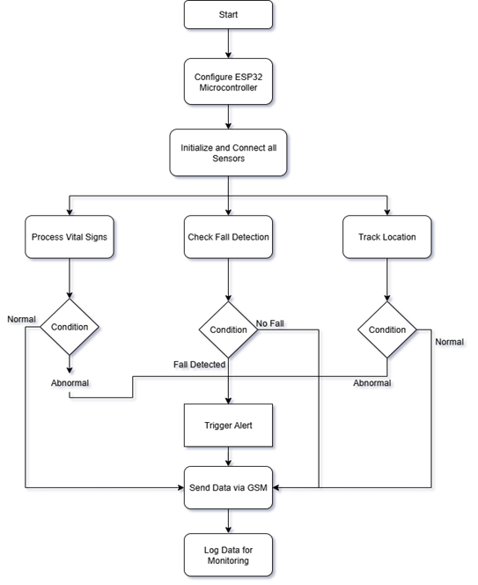
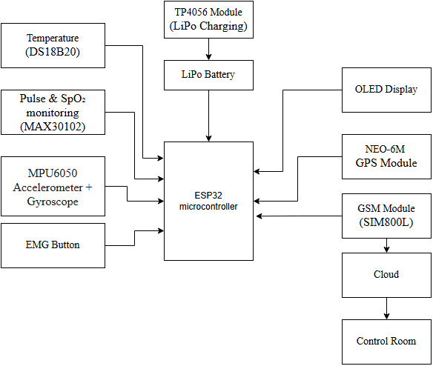
System Overview:

Slide 4
Hardware Components :
ESP32 Development Board
Specification: Wi-Fi + BLE
Functionality: Central unit for orchestrating data collection, processing, and communication.
GPS Module (NEO-6M)
Specification: GPS Tracking Module
Functionality: Provides real-time latitude, longitude, and altitude data.
GSM Module (SIM800L / SIM900A)
Specification: Cellular Communication (2G/3G/4G capable)
Functionality: Enables wide-area data connectivity.
MAX30102 Sensor
Specification: Pulse Oximetry & Heart Rate Monitor
Functionality: Measures heart rate and SpO₂ using PPG (Photoplethysmography).
DS18B20 Temperature Sensor
Specification: Digital Temperature Sensor
Functionality: Provides precise temperature readings via 1-Wire interface.
MPU6050
Specification: 6-axis IMU (Accelerometer + Gyroscope)
Functionality: Detects movement, orientation, and fall detection.
OLED Display (0.96” I²C 128×64)
Specification: Compact OLED Module
Functionality: Displays health metrics (pulse, SpO₂) directly.
Li-Po Battery (3.7V 1000–1500mAh)
Specification: Rechargeable Li-Po
Functionality: Powers the system, managed by TP4056 charging module.
Glove Base + Mounting Material
Specification: Textile glove, Velcro, tape, casing
Functionality: Provides ergonomic integration and houses all components.

Slide 5
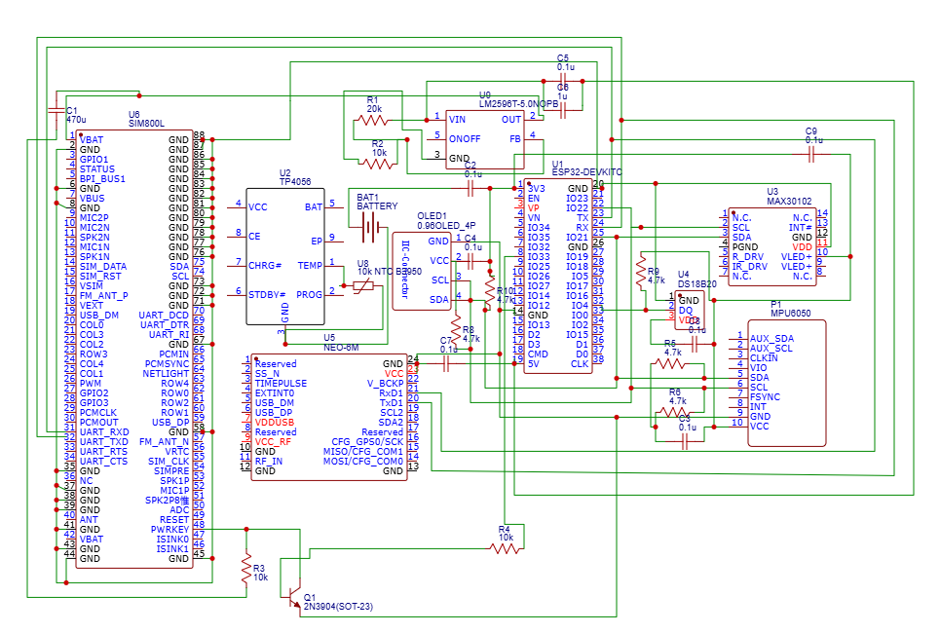
Schematic Diagram & Interconnection :

Slide 6
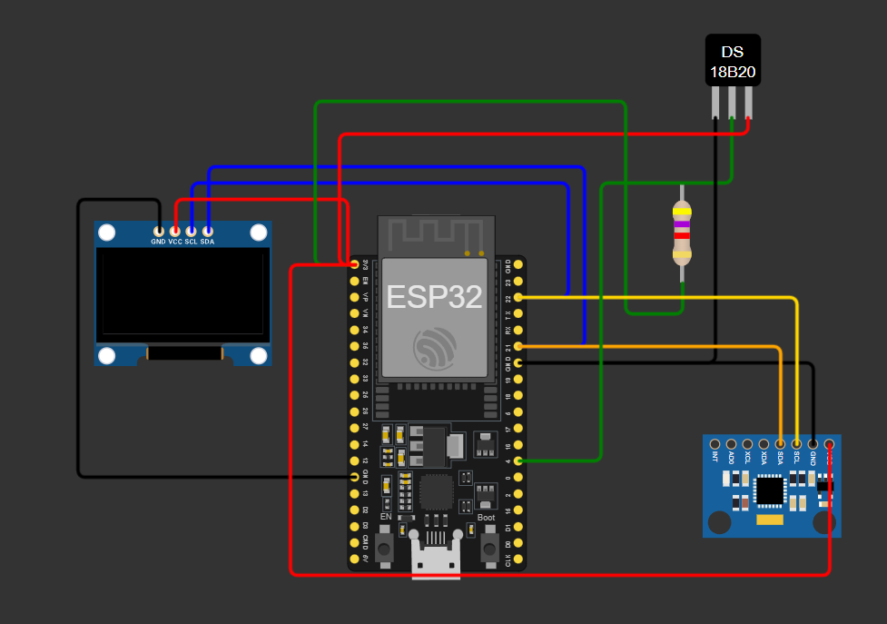
Simulation Setup on Wokwi
Simulation Platform: Wokwi
Sensors Used:
DS18B20 – Temperature monitoring
MPU6050 – Motion/acceleration detection
Process Flow:
Sensors collect vital data.
Data is displayed on the Serial Monitor for verification.
Sensor data is sent via ESP32 to ThingSpeak Cloud.
From ThingSpeak, the data is forwarded to a Local Database for storage and further analysis.
The diagram illustrates the virtual circuit, mirroring our planned hardware implementation. This simulation on Wokwi provides valuable insights into the system's behavior, paving the way for a smooth transition to physical hardware.

Slide 7
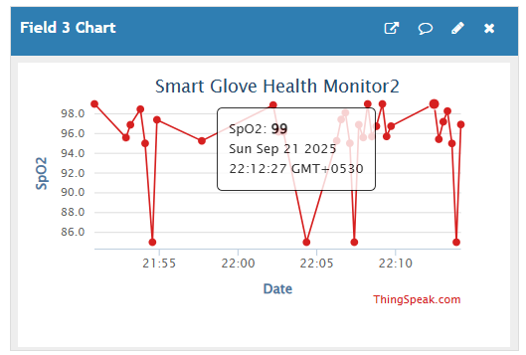
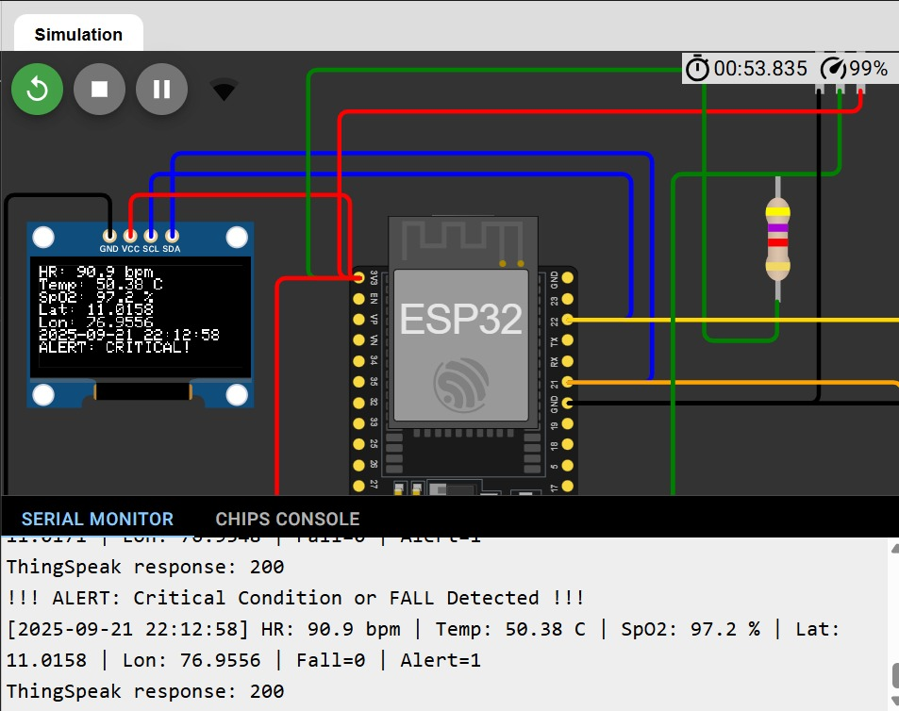

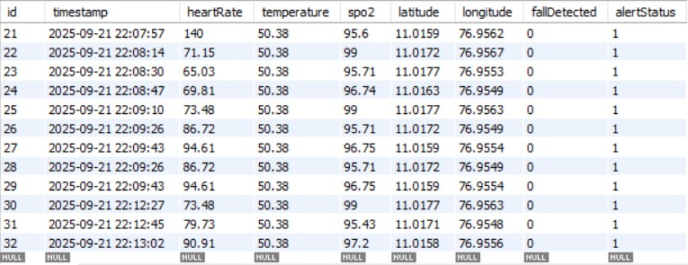
ThingSpeak & Database Demo Outputs
Heart Rate Monitoring
Body Temperature Trends
Observed heart rates consistently fall within the normal range of 72–85 BPM, indicating stable cardiac activity within the simulated environment.
Temperature readings maintain a healthy range of 36.5-37.5°C, validating sensor accuracy for thermoregulation monitoring.
These initial results validate the functionality of our data acquisition and transmission, aligning with expected healthy vital sign values.

Slide 8
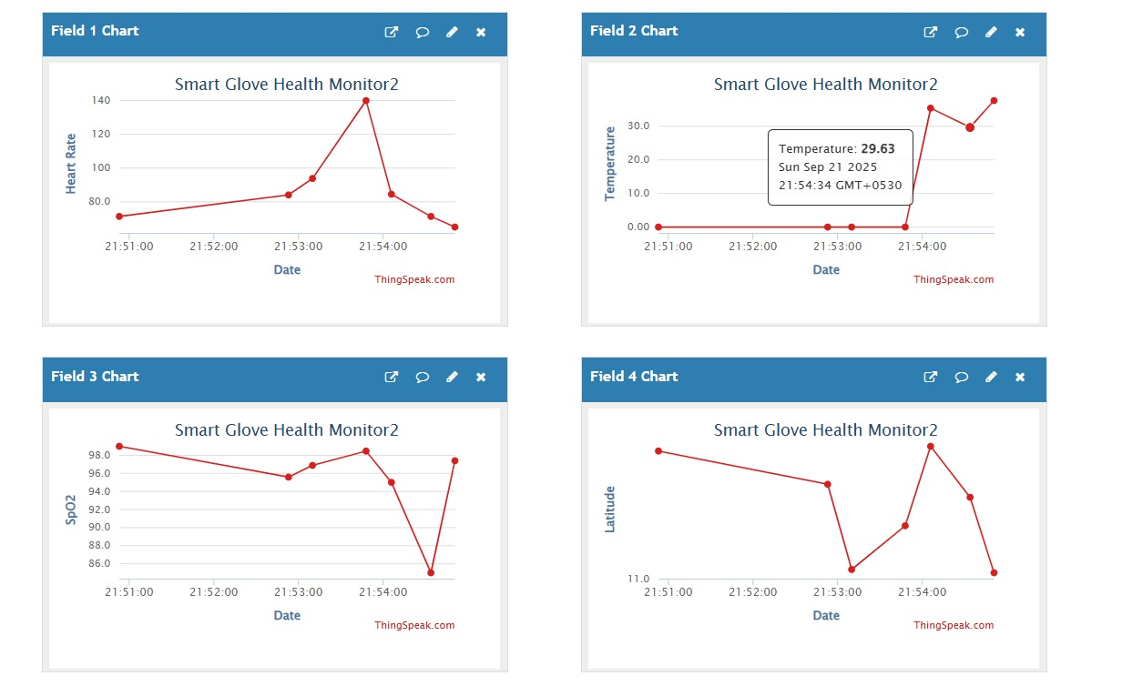
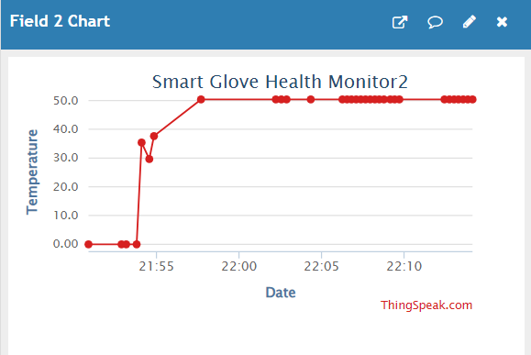
Data Flow Verification :
Manual sensor values entered in Wokwi were successfully captured by DS18B20 & MPU6050.
Values were printed in the Serial Monitor and transmitted to ThingSpeak Cloud.
Data was further stored in the Local Database, confirming smooth end-to-end flow.
ThingSpeak Graphs :
Line charts showed correct reflection of manually varied sensor inputs.
Demonstrated the system’s ability to log and visualize changes in real-time.
Observations :
Data transfer chain
(Sensor → ESP32 → ThingSpeak → Local DB) was consistent.
No packet loss noticed in simulation.
System can handle continuous monitoring if real sensors are connected.
Analysis of Readings :

Slide 9

Design Considerations for Real Hardware:
Sensor Placement & Comfort – Strategically position sensors on the fingers, palm, and wrist to ensure precise vital sign measurements while maintaining user comfort. Integrate sensors seamlessly into the glove design.
Power Management – Use a rechargeable Li-ion or LiPo battery with an efficient charging circuit. Include low-battery alerts to ensure uninterrupted monitoring.
Signal Conditioning & Filtering – Implement hardware and software filters to reduce noise and enhance the accuracy of sensor readings.
Data Reliability – Store data locally on ESP32 flash memory or an SD card as a backup when Wi-Fi connectivity is unavailable. Ensure secure transfer of data to ThingSpeak or a local database for continuous monitoring.
Alerts & User Feedback – Provide immediate feedback via a buzzer, vibration motor, or LED indicators when abnormal vital signs are detected.
Enclosure & Safety – Design the glove using comfortable, non-toxic materials and ensure all electronics are insulated to protect the user.

Slide 10
Challenges Encountered
. PCB Design Constraints: Optimizing board size and component placement for a wearable form factor presented significant design challenges.
Simulation Limitations: Wokwi provides good emulation but cannot use GSM module to for Communication data.
The next phase will transition from simulation to tangible hardware implementation and advanced features.
Hardware Fabrication & Testing: Manufacture the designed PCB and rigorously test it within the physical glove.
Expanded Sensor Integration: Incorporate additional vital sensors which isnt fully implemented in simulation to broaden monitoring capabilities.
Web App Integration: Develop a companion web application for personalized alerts, historical data access, and enhanced interaction.
Positive Observations
Seamless IoT connectivity and reliable data plotting on ThingSpeak were successfully demonstrated.
The core system functionality, from sensor reading to cloud visualization, Database logging performed as expected.

Slide 11
THANK YOU

